Slide 1
Multiple Access

Slide 2
Sublayers of Data Link Layer
LOGICAL LINK CONTROL
MEDIUM ACCESS CONTROL

Slide 3
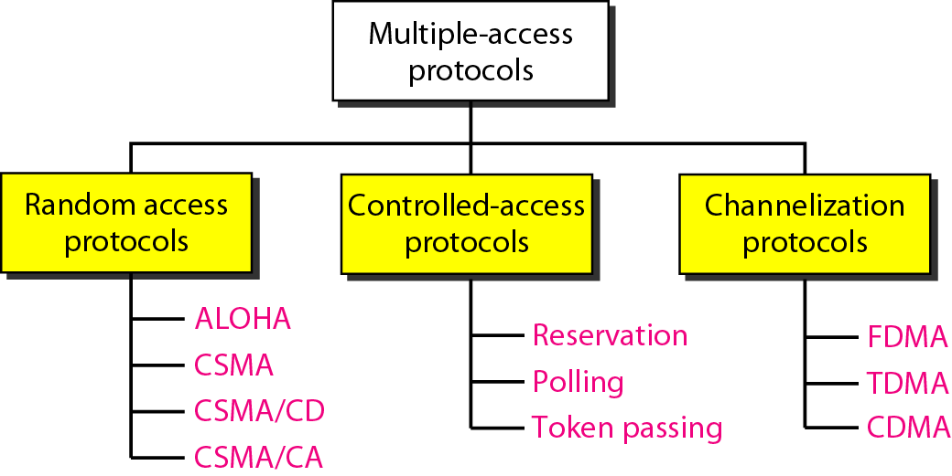
Multiple Access Mechanisms

Slide 4
Random Access

Slide 5
Random Access
Also called contention-based access
No station is assigned to control another

Slide 6
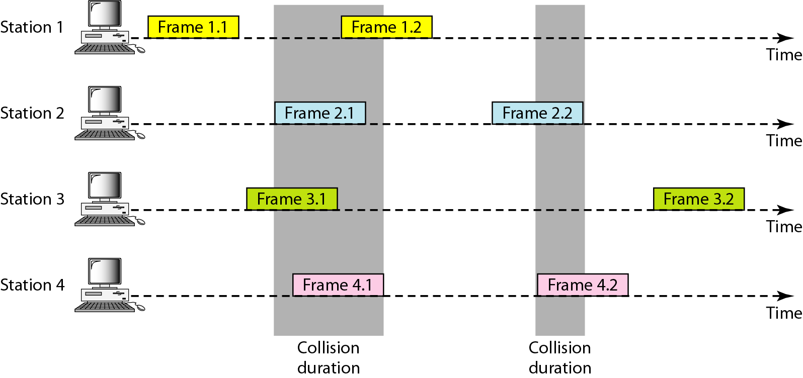
Frames in Pure ALOHA

Slide 7
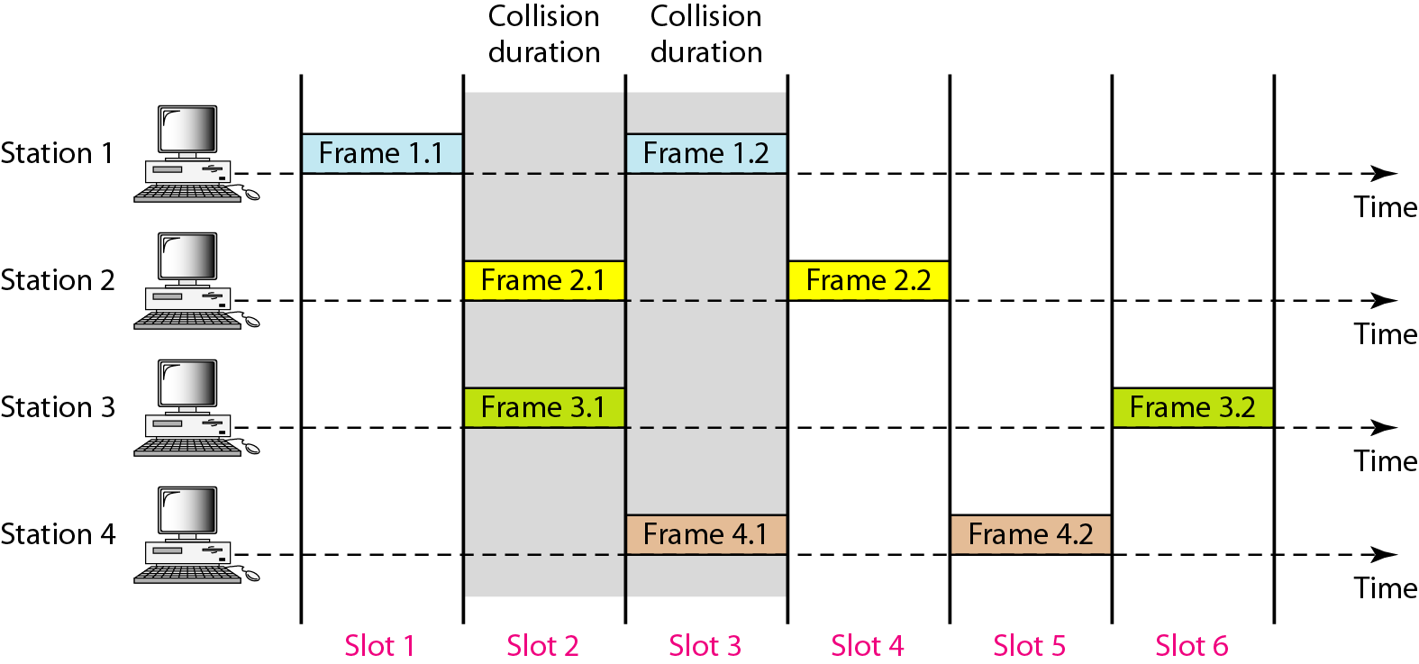
Slotted ALOHA

Slide 8
CSMA
Carrier Sense Multiple Access
"Listen before talk"
Reduce the possibility of collision
But cannot completely eliminate it

Slide 9
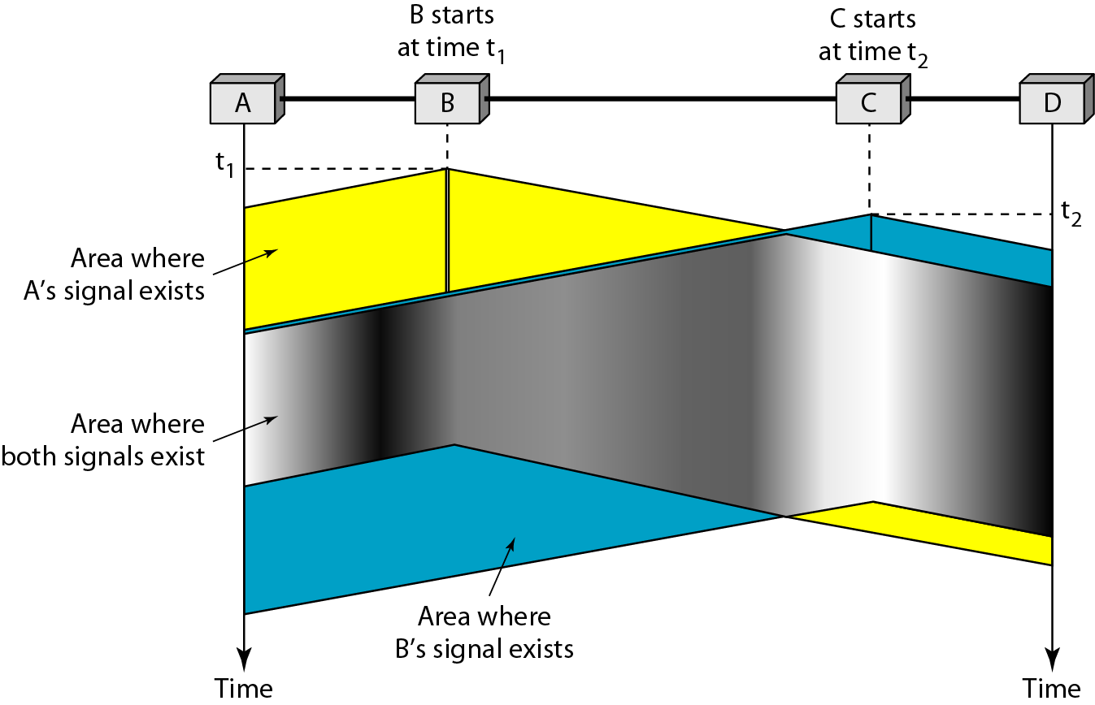
Collision in CSMA
B
C

Slide 10
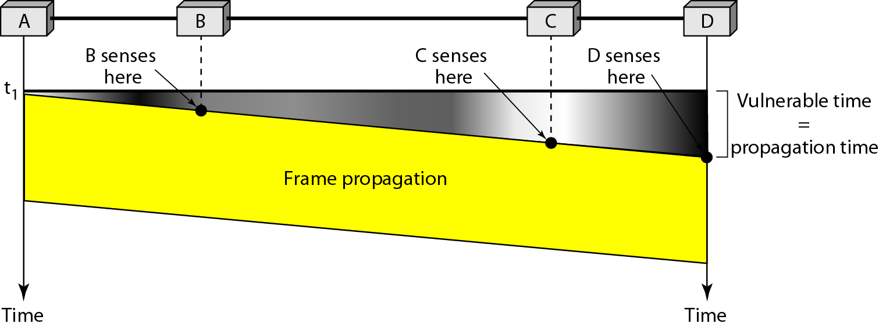
CSMA: Vulnerable Time

Slide 11
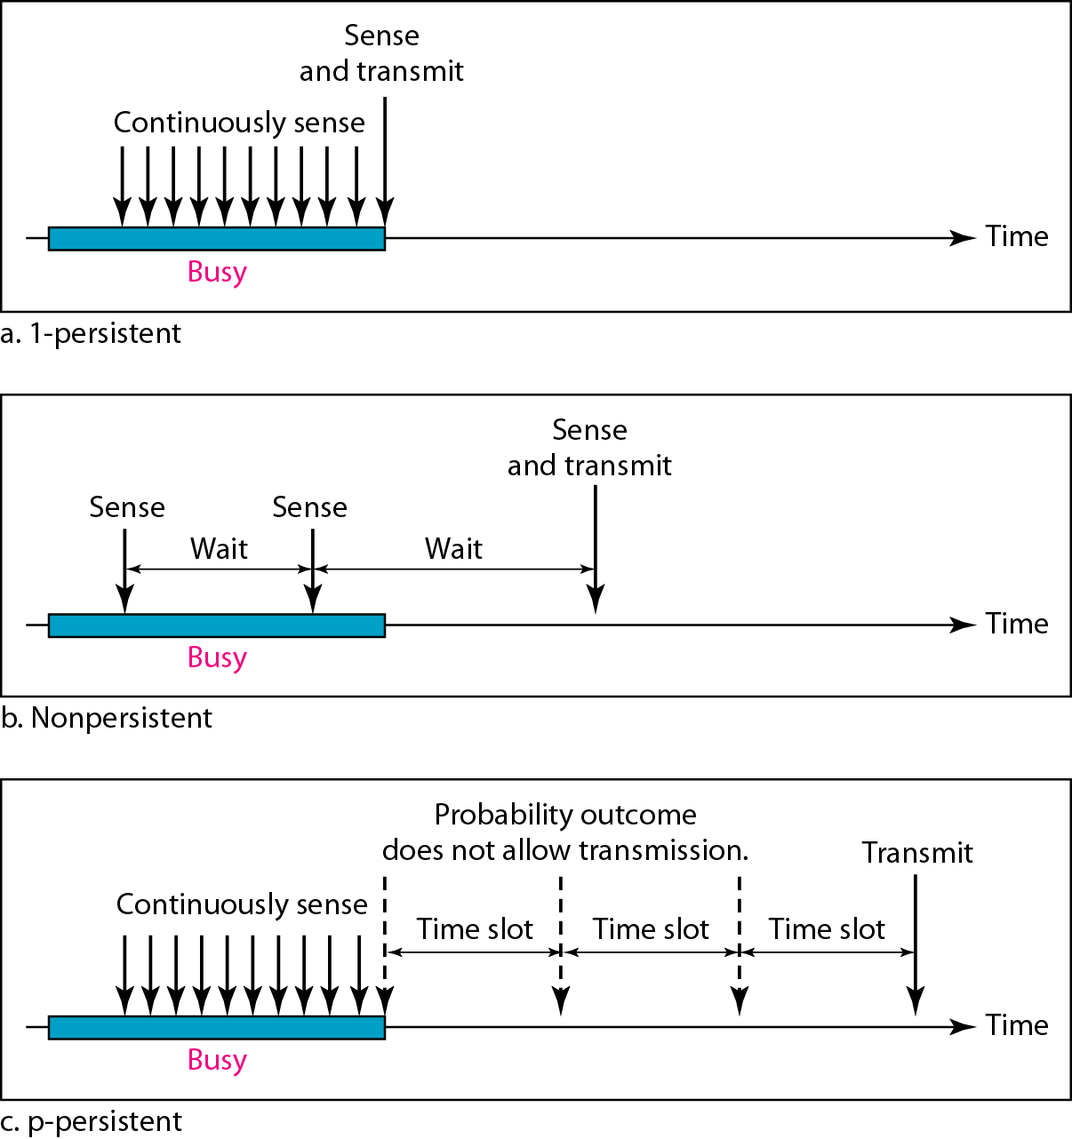
Persistence Methods
What a station does when channel is idle or busy

Slide 12
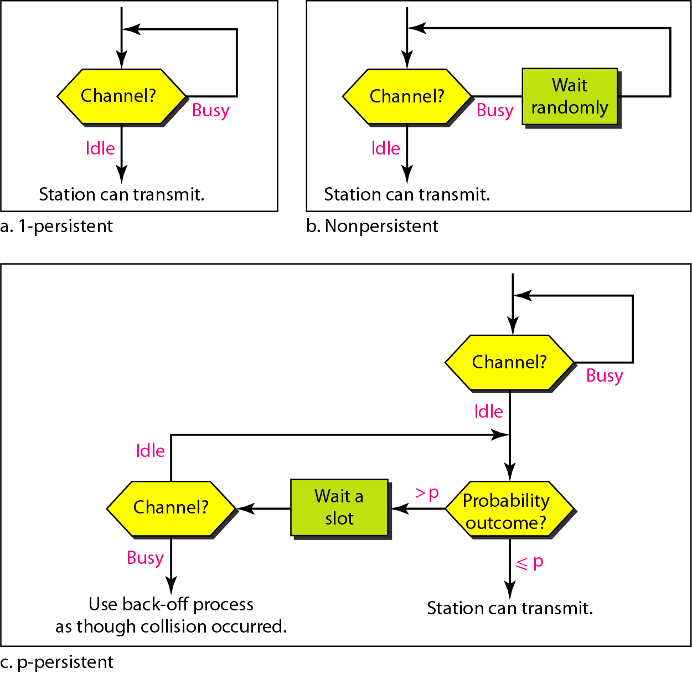
Persistence Methods

Slide 13
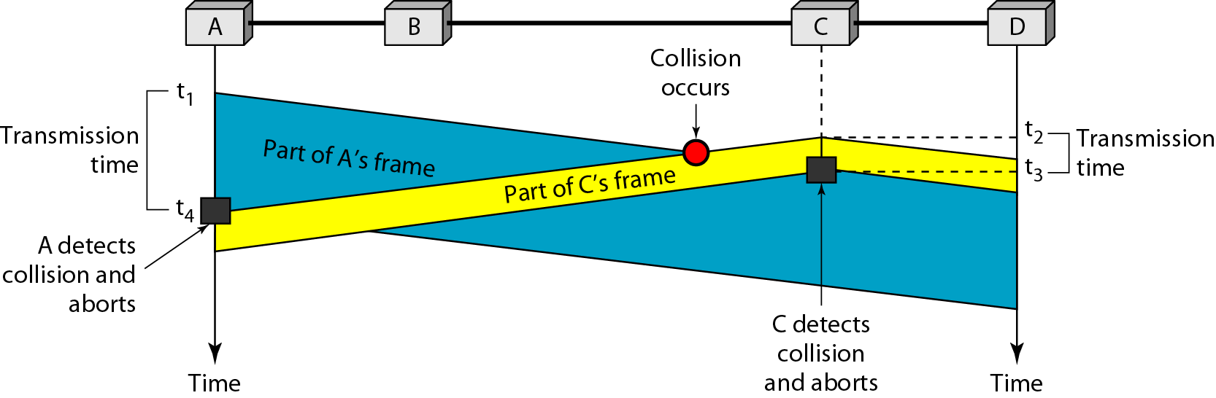
CSMA/CD
Carrier Sense Multiple Access with Collision Detection
Station monitors channel while sending a frame

Slide 14
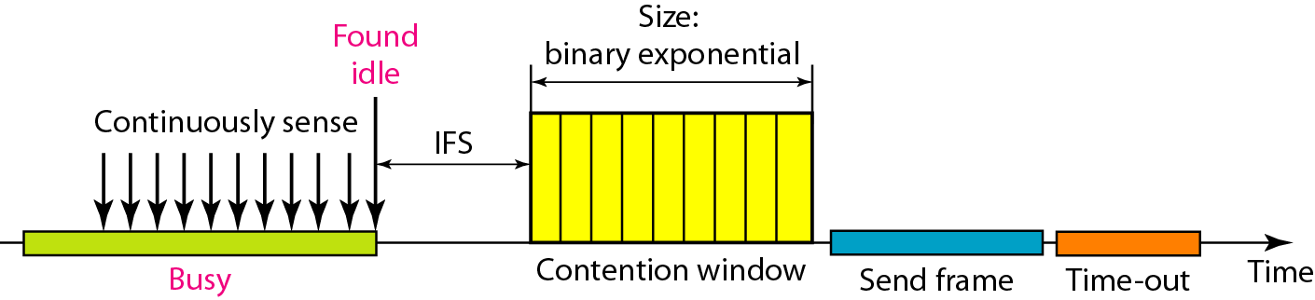
CSMA/CA
Carrier Sense Multiple Access with Collision Avoidance
Used in a network where collision cannot be detected
E.g., wireless LAN
IFS – Interframe Space

Slide 15
Controlled Access

Slide 16
Control Access
A station must be authorized by someone (e.g., other stations) before transmitting
Three common methods:
Reservation
Polling
Token passing

Slide 17
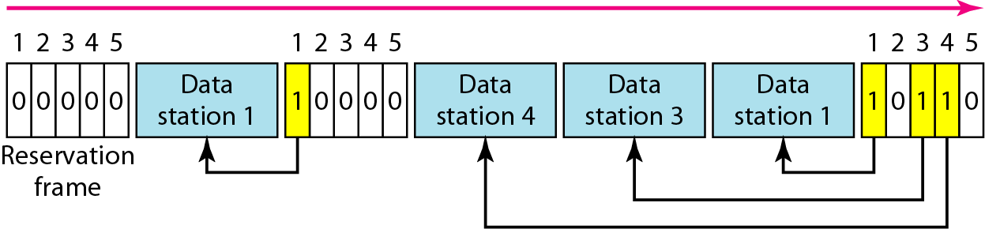
Reservation Method

Slide 18
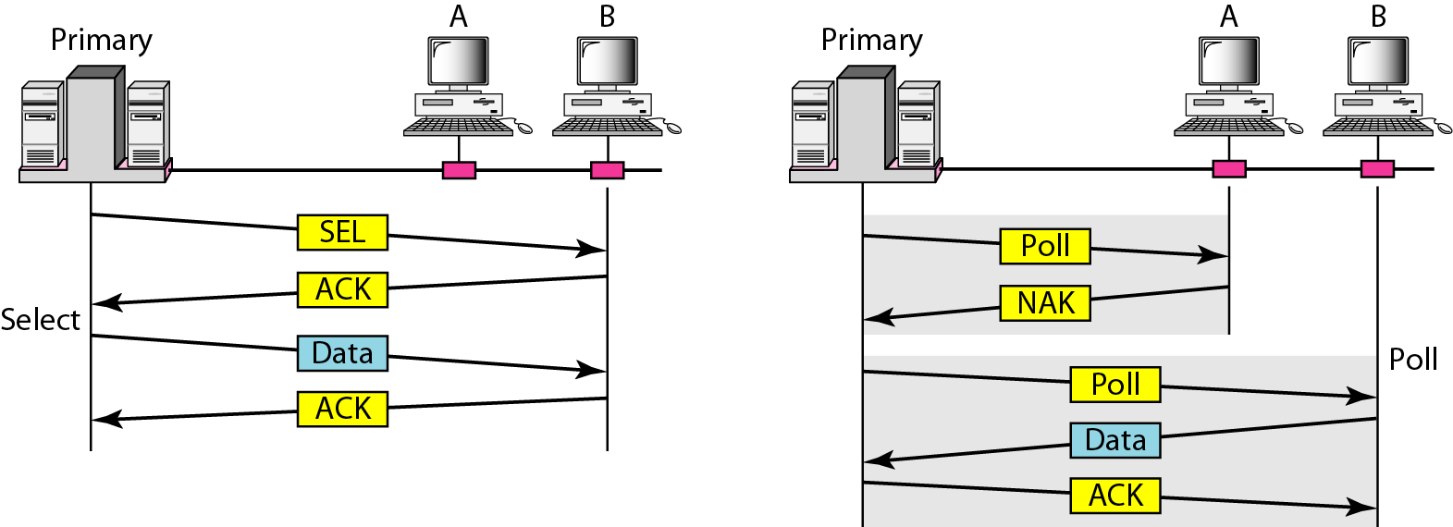
Polling Method

Slide 19
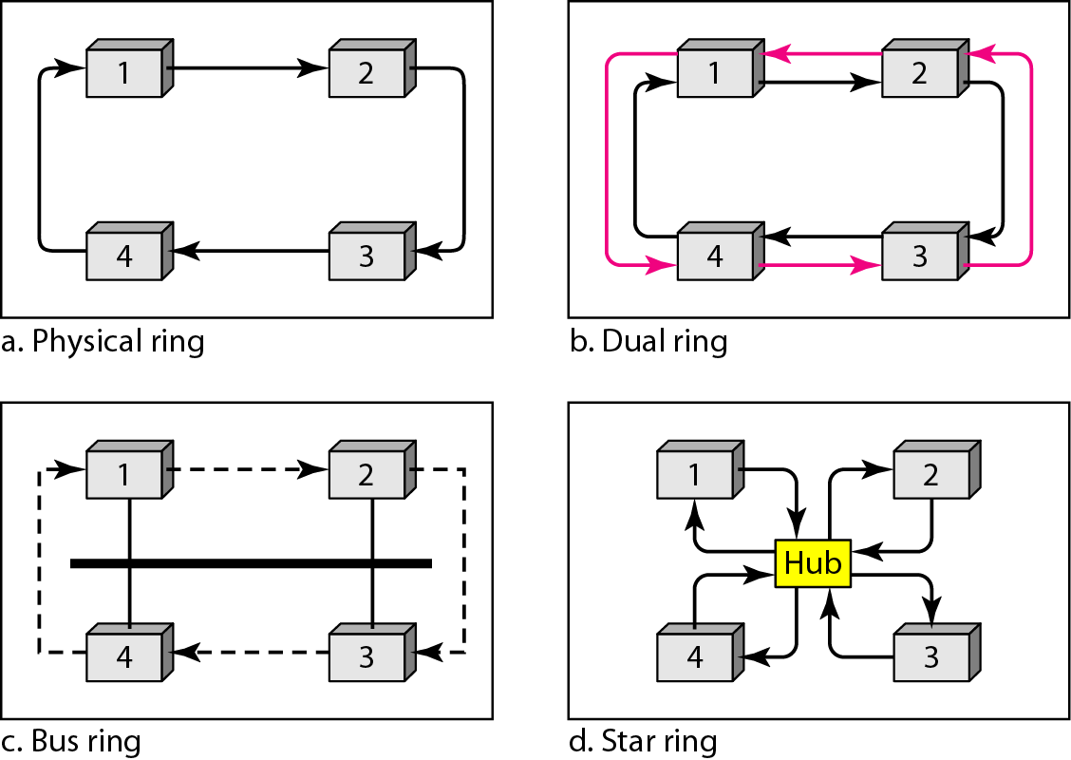
Token Passing

Slide 20
Channelization

Slide 21
Channelization
Similar to multiplexing
Three schemes
Frequency-Division Multiple Access (FDMA)
Time-Division Multiple Access (TDMA)
Code-Division Multiple Access (CDMA)

Slide 22
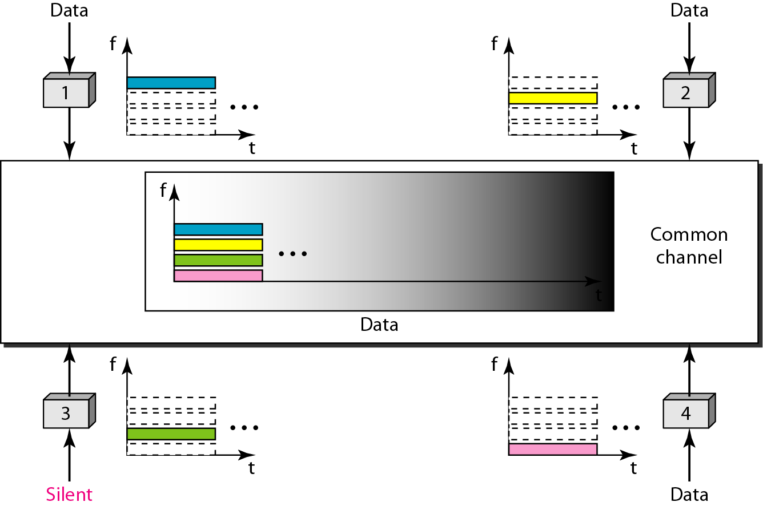
FDMA

Slide 23
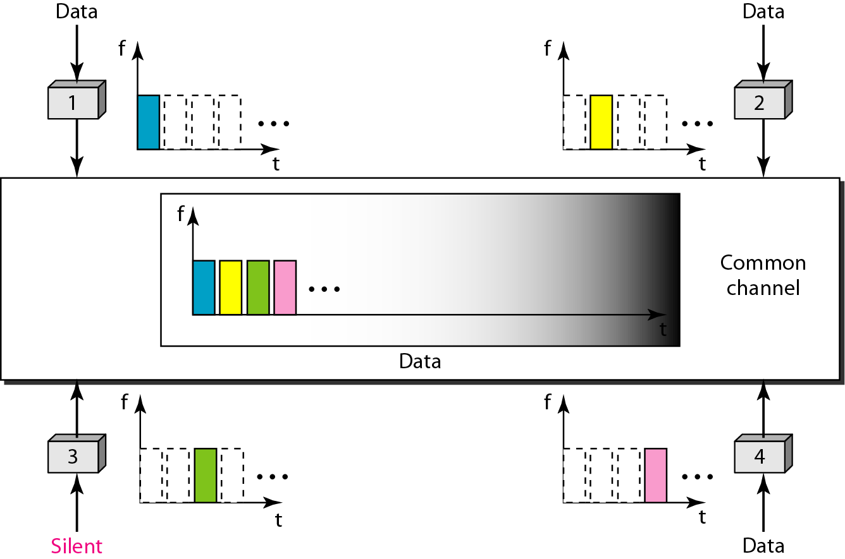
TDMA

Slide 24
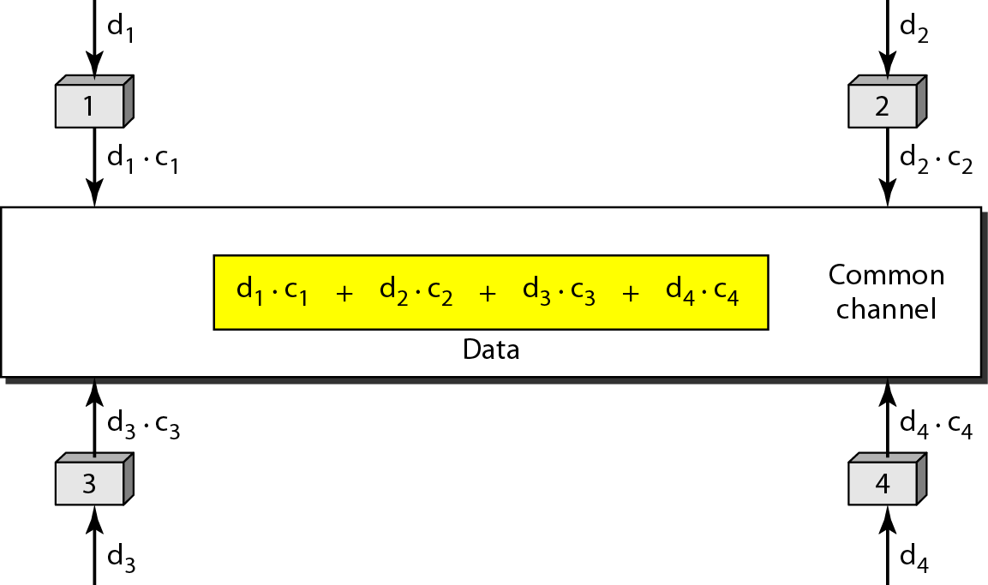
CDMA
One channel carries all transmissions at the same time
Each channel is separated by code

